Slide 1
Frequency Distributions

Slide 2
Frequency Distributions
After collecting data, the first task for a researcher is to organize and simplify the data so that it is possible to get a general overview of the results.
This is the goal of descriptive statistical techniques.
One method for simplifying and organizing data is to construct a frequency distribution.

Slide 3
Frequency Distributions (cont.)
A frequency distribution is an organized tabulation showing exactly how many individuals are located in each category on the scale of measurement. A frequency distribution presents an organized picture of the entire set of scores, and it shows where each individual is located relative to others in the distribution.

Slide 4
Frequency Distribution Tables
A frequency distribution table consists of at least two columns - one listing categories on the scale of measurement (X) and another for frequency (f).
In the X column, values are listed from the highest to lowest, without skipping any.
For the frequency column, tallies are determined for each value (how often each X value occurs in the data set). These tallies are the frequencies for each X value.
The sum of the frequencies should equal N.

Slide 5
Frequency Distribution Tables (cont.)
A third column can be used for the proportion (p) for each category: p = f/N. The sum of the p column should equal 1.00.
A fourth column can display the percentage of the distribution corresponding to each X value. The percentage is found by multiplying p by 100. The sum of the percentage column is 100%.

Slide 6
Regular Frequency Distribution
When a frequency distribution table lists all of the individual categories (X values) it is called a regular frequency distribution.

Slide 7
Grouped Frequency Distribution
Sometimes, however, a set of scores covers a wide range of values. In these situations, a list of all the X values would be quite long - too long to be a “simple” presentation of the data.
To remedy this situation, a grouped frequency distribution table is used.

Slide 8
Grouped Frequency Distribution (cont.)
In a grouped table, the X column lists groups of scores, called class intervals, rather than individual values.
These intervals all have the same width, usually a simple number such as 2, 5, 10, and so on.
Each interval begins with a value that is a multiple of the interval width. The interval width is selected so that the table will have approximately ten intervals.

Slide 9
Frequency Distribution Graphs
In a frequency distribution graph, the score categories (X values) are listed on the X axis and the frequencies are listed on the Y axis.
When the score categories consist of numerical scores from an interval or ratio scale, the graph should be either a histogram or a polygon.

Slide 10
Histograms
In a histogram, a bar is centered above each score (or class interval) so that the height of the bar corresponds to the frequency and the width extends to the real limits, so that adjacent bars touch.

Slide 11
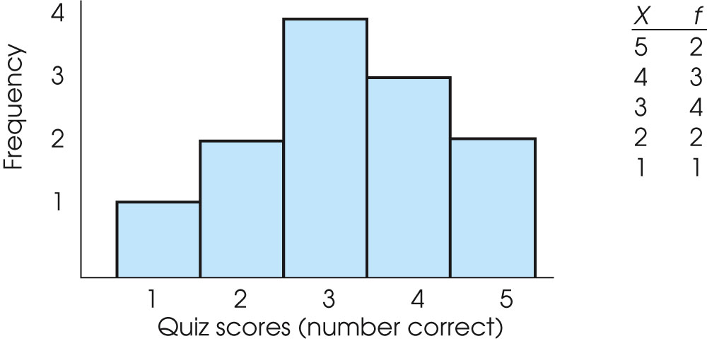
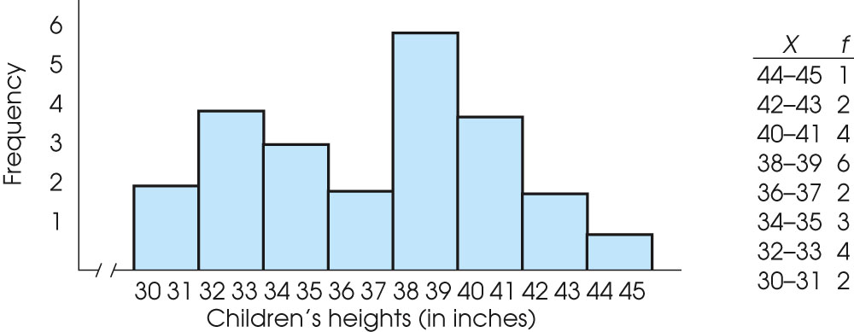
Notes:
Figure 2.2
An example of a frequency distribution histogram. The same set of quiz scores is presented in a frequency distribution table and in a histogram.
Figure 2.3
An example of a frequency distribution histogram for grouped data. The same set of children’s heights is presented in a frequency distribution table and in a histogram.

Slide 12
Polygons
In a polygon, a dot is centered above each score so that the height of the dot corresponds to the frequency. The dots are then connected by straight lines. An additional line is drawn at each end to bring the graph back to a zero frequency.

Slide 13
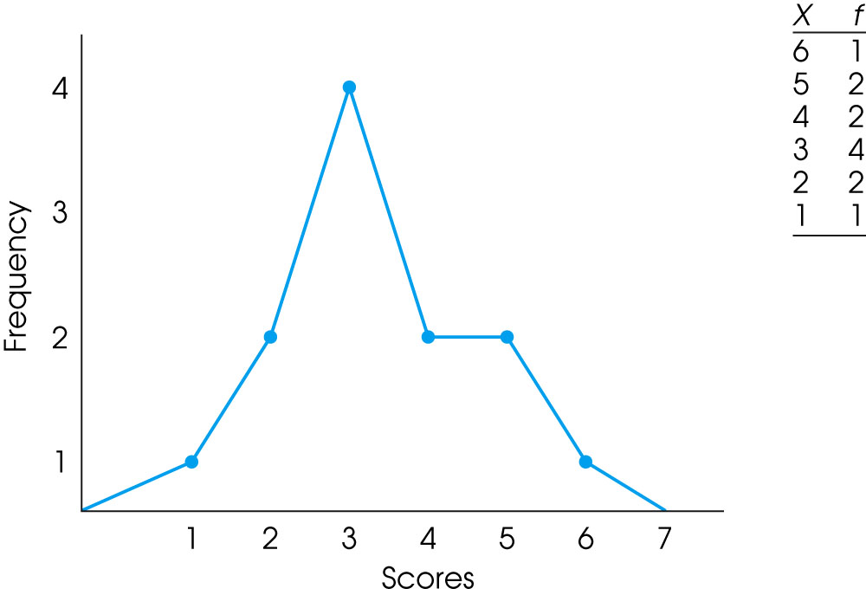
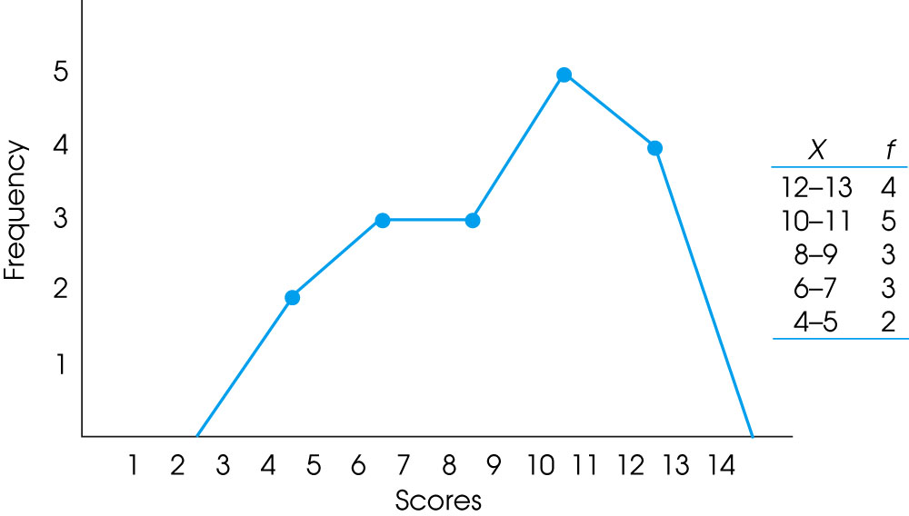
Notes:
Figure 2.5
An example of a frequency distribution polygon. The same set of data is presented in a frequency distribution table and in a polygon.
Figure 2.6
An example of a frequency distribution polygon for grouped data. The same set of data is presented in a grouped frequency distribution table and in a polygon.

Slide 14
Bar graphs
When the score categories (X values) are measurements from a nominal or an ordinal scale, the graph should be a bar graph.
A bar graph is just like a histogram except that gaps or spaces are left between adjacent bars.

Slide 15
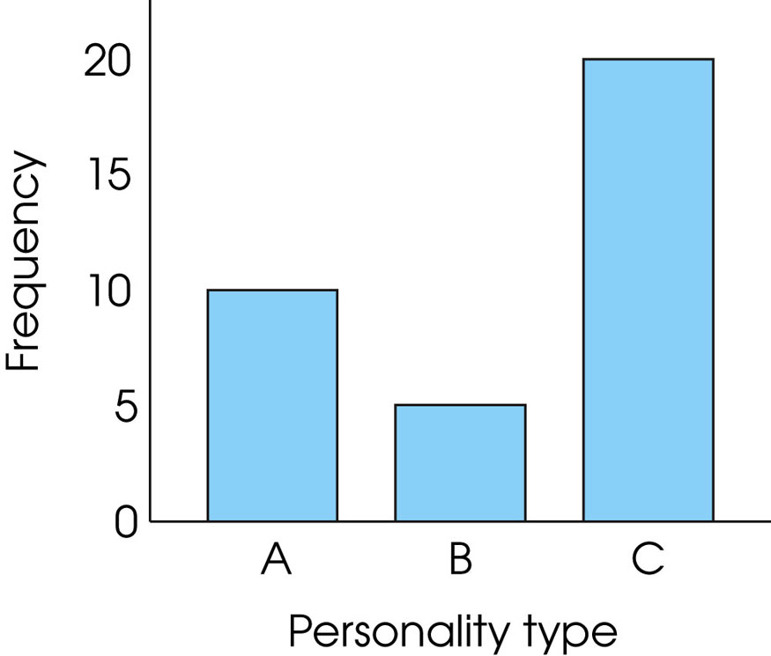
Notes:
Figure 2.7
A bar graph showing the distribution of personality types in a sample of college students. Because personality type is a discrete variable measured on a nominal scale, the graph is drawn with space between the bars.

Slide 16
Relative frequency
Many populations are so large that it is impossible to know the exact number of individuals (frequency) for any specific category.
In these situations, population distributions can be shown using relative frequency instead of the absolute number of individuals for each category.

Slide 17
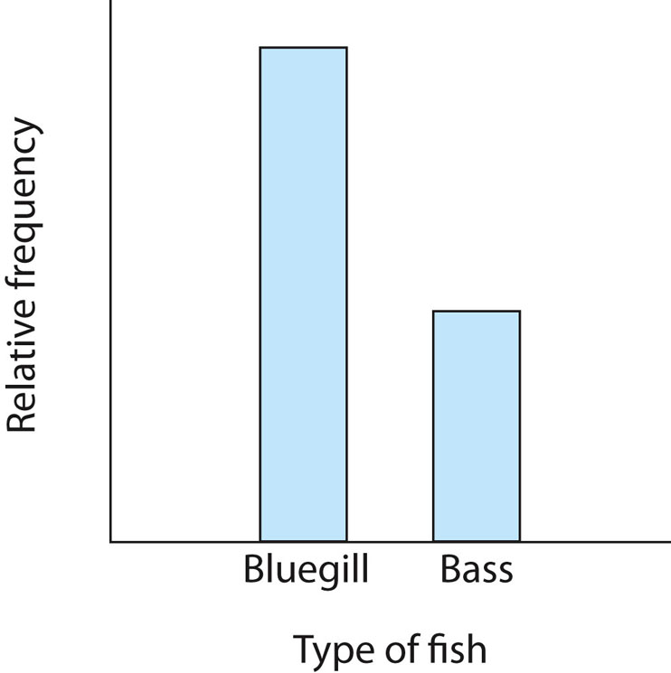
Notes:
Figure 2.8
A frequency distribution showing the relative frequency for two types of fish. Notice that the exact number of fish is not reported; the graph simply says that there are twice as many bluegill as there are bass.

Slide 18
Smooth curve
If the scores in the population are measured on an interval or ratio scale, it is customary to present the distribution as a smooth curve rather than a jagged histogram or polygon.
The smooth curve emphasizes the fact that the distribution is not showing the exact frequency for each category.

Slide 19
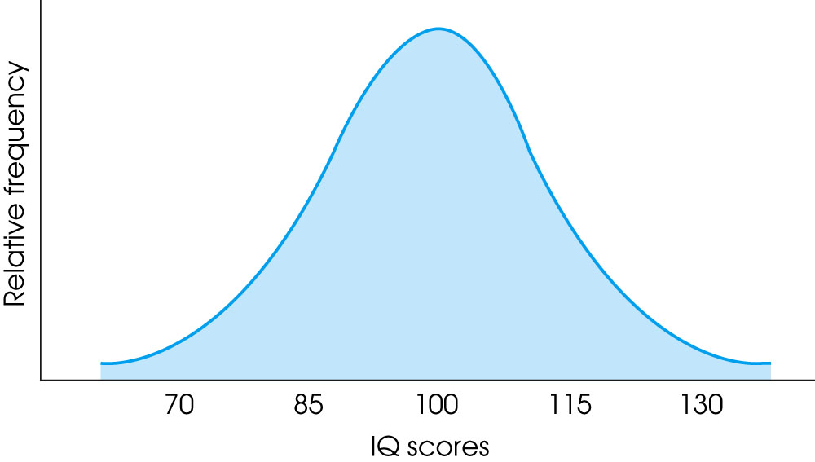
Notes:
Figure 2.9
The population distribution of IQ scores: an example of a normal distribution.

Slide 20
Frequency distribution graphs
Frequency distribution graphs are useful because they show the entire set of scores.
At a glance, you can determine the highest score, the lowest score, and where the scores are centered.
The graph also shows whether the scores are clustered together or scattered over a wide range.

Slide 21
Shape
A graph shows the shape of the distribution.
A distribution is symmetrical if the left side of the graph is (roughly) a mirror image of the right side.
One example of a symmetrical distribution is the bell-shaped normal distribution.
On the other hand, distributions are skewed when scores pile up on one side of the distribution, leaving a "tail" of a few extreme values on the other side.

Slide 22
Positively and Negatively Skewed Distributions
In a positively skewed distribution, the scores tend to pile up on the left side of the distribution with the tail tapering off to the right.
In a negatively skewed distribution, the scores tend to pile up on the right side and the tail points to the left.

Slide 23
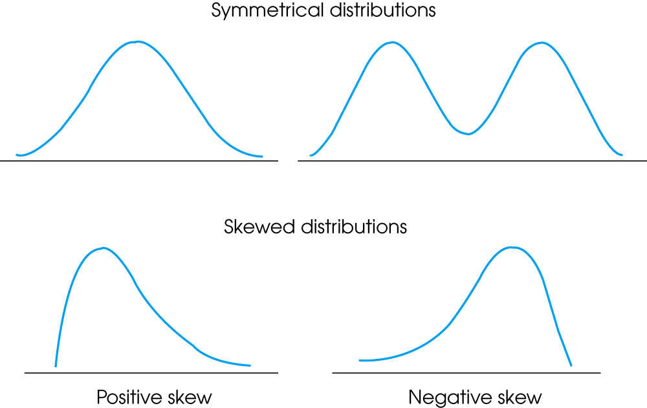
Notes:
Figure 2.11
Examples of different shapes for distributions.

Slide 24
Percentiles, Percentile Ranks, and Interpolation
The relative location of individual scores within a distribution can be described by percentiles and percentile ranks.
The percentile rank for a particular X value is the percentage of individuals with scores equal to or less than that X value.
When an X value is described by its rank, it is called a percentile.

Slide 25
Percentiles, Percentile Ranks, and Interpolation (cont.)
To find percentiles and percentile ranks, two new columns are placed in the frequency distribution table: One is for cumulative frequency (cf) and the other is for cumulative percentage (c%).
Each cumulative percentage identifies the percentile rank for the upper real limit of the corresponding score or class interval. When scores or percentages do not correspond to upper real limits or cumulative percentages, you must use interpolation to determine the corresponding ranks and percentiles. Interpolation is a mathematical process based on the assumption that the scores and the percentages change in a regular, linear fashion as you move through an interval from one end to the other.

Slide 26
Interpolation
When scores or percentages do not correspond to upper real limits or cumulative percentages, you must use interpolation to determine the corresponding ranks and percentiles.
Interpolation is a mathematical process based on the assumption that the scores and the percentages change in a regular, linear fashion as you move through an interval from one end to the other.

Slide 27
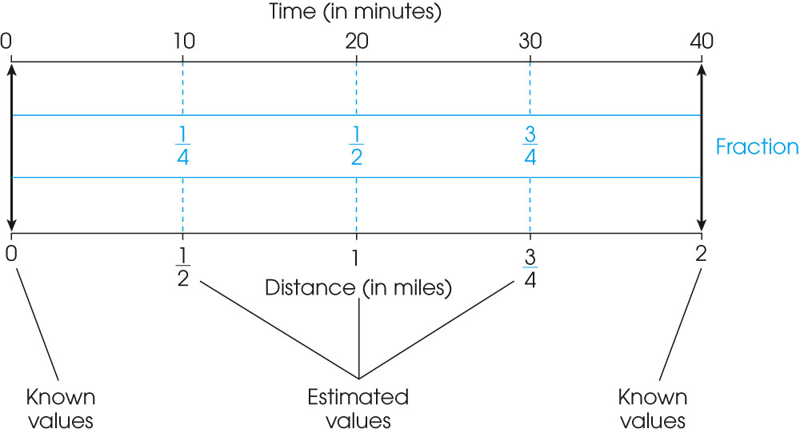
Notes:
Figure 2.14
A graphic representation of the process of interpolation. The same interval is shown on two separate scales, time and distance. Only the endpoints of the scales are known – Bob starts at 0 for both time and distance, and he ends at 40 minutes and 2 miles. Interpolation is used to estimate values within the interval by assuming that fractional portions of one scale correspond to the same fractional portions of the other. For example, it is assumed that halfway through the time scale corresponds to halfway through the distance scale.

Slide 28
Stem-and-Leaf Displays
A stem-and-leaf display provides a very efficient method for obtaining and displaying a frequency distribution.
Each score is divided into a stem consisting of the first digit or digits, and a leaf consisting of the final digit.
Finally, you go through the list of scores, one at a time, and write the leaf for each score beside its stem.
The resulting display provides an organized picture of the entire distribution. The number of leafs beside each stem corresponds to the frequency, and the individual leafs identify the individual scores.

Slide 29
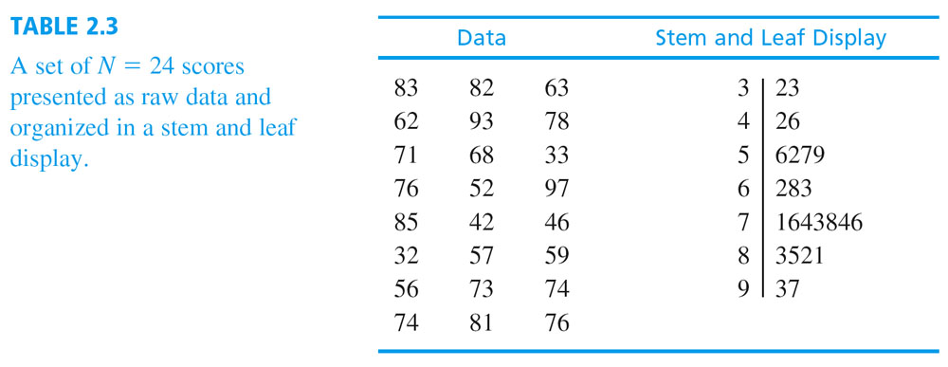
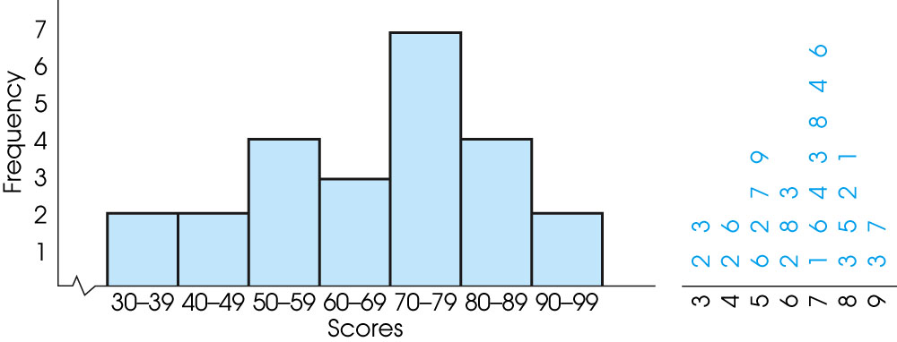
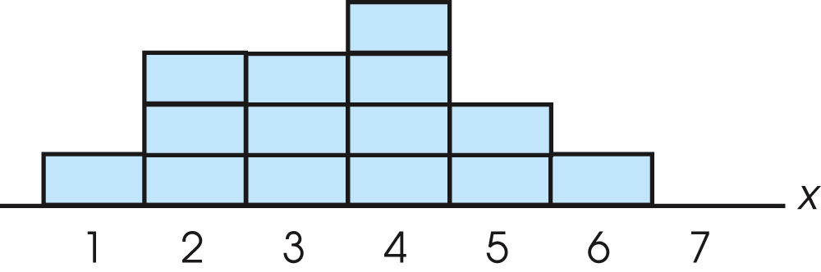
Notes:
Figure 2.15
A grouped frequency distribution histogram and a stem and leaf display showing the distribution of scores from Table 2.3. The stem and leaf display is placed on its side to demonstrate that the display gives the same information provided in the histogram.
Figure 2.4
A frequency distribution in which each individual is represented by a block placed directly above the individual’s score. For example, three people had scores of X = 2.

Slide 30
Thank you

